Slide 2
GUIDING PRINCIPLES
NOT A MOMENT IN TIME BUT A CONTINUATION OF HISTORY
CREATION OF THE “OTHER”
DE-SENSATIONALIZE THE RHETORIC OF NATIONAL SECURITY
ANCHORED IN HUMAN RIGHTS – THE FIGHT IS TO DISMANTLE AND NOT LIMITED TO CONSTITUTIONAL OR CIVIL RIGHTS AND CIVIL LIBERTIES

Slide 3
Edward Banfield “The Unheavenly City”
The implication that lower-class culture is pathological seems fully warranted. Rather than waste time and public money implementing policies based on the false notion that all men were created equal, better to just face facts and acknowledge the natural divisions that exist. Members of the lower classes should leave school in ninth grade, to get a jump on a lifetime of manual labor. The minimum wage should be repealed to encourage employers to create more jobs for “low-value labor.” The state should give “intensive birth-control guidance to the incompetent poor.” And the police should feel free to crack down on young lower-class men.

Slide 4
DIRECTOR OF NATIONAL INTELLIGENCE DEFINES SUSPICIOUS ACTIVITY AS:
“observed behavior reasonably indicative of pre-operational planning related to terrorism or other criminal activity”

Slide 5
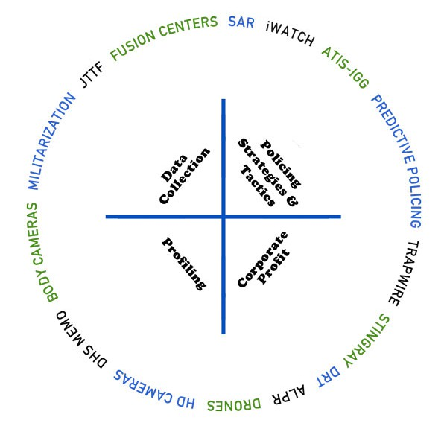
LAPD ARCHITECTURE OF SURVEILLANCE https://stoplapdspying.org/policing-strategies-and-tactics/

Slide 6
STINGRAY IMSI Catcher – International Mobile Subscriber Identity Also Known As - KINGFISH, BLACKFIN ETC.

Slide 7
DIGITAL RECEIVER TECHNOLOGY DRT BOXES

Slide 8
TRAPWIRE

Slide 9
HI-DEFINITION CAMERAS

Slide 10
AUTOMATIC LICENSE PLATE READER

Slide 11
DRONES

Slide 12
BODY CAMERA

Slide 13
The process of collecting and monitoring (1)
1) A police officer observes “something suspicious” ad fills out a SAR – Suspicious Activity Report. Under Special Order 1 this means reporting non-criminal activities such as taking a picture of a building, drawing or painting a landmark, drawing diagrams or taking notes in public, using binoculars or inquiring about a building’s hours of operation
2) All SARs are sent to the Counter Terrorism Special Operations Bureau (CTSOB) of the LAPD’s Major Crimes Division (MCD).

Slide 14
The process of collecting and monitoring (2)
3) The SARs information is often shared with the Joint Regional Information Center also know as the FUSION CENTER
4) The SARs information can then be uploaded by the Fusion Centers onto the Information Sharing Environment (ISE), a National Database.

Slide 15
Community Concerns
Creates a Culture of Fear and Suspicion
Promotes Racial Profiling
Violation of Basic Human and Civil Rights
Not Evidence Based
Wastes Resources

Slide 16
DEMANDS
1. Total prohibition on the acquisition of any new surveillance technology or development of surveillance program;
2. Immediate abolition of any and all current use of surveillance technology and programs;
3. Full disclosure on the use of surveillance technology and programs since their inception including informing individuals and organizations who have been targeted;
4. Full reparations for individuals and organizations whose civil and constitutional rights have been violated;
5. Immediately cease all funding for state surveillance programs and divert those resources to invest in the health and well being of our communities. We urgently need more investments in public housing, education, health centers, youth development programs, healthy food, and steady employment – factors that promote real public safety.

Slide 17
CAMPAIGNS
Our Communities, Our Bodies, Our Stories, Our Data
Community Meetings Every 1st Monday at 6 PM.
LA CAN – 838 E. 6th St., LA 90021. X-St Gladys
Surveillance and Targeting of Students K thru 12
Community Meeting Every 2nd Tuesday at 6:00 PM.
LA CAN – 838 E. 6th St., LA 90021. X-St Gladys
Coalition General Meeting - UCLA Downtown Labor Ctr
675 S. Parkview St., Los Angeles 90057
Every Third Tuesday – 6 PM
Predictive Policing
Community Meeting Every 4th Tuesday at 6 PM.
LA CAN – 838 E. 6th St., LA 90021. X-St Gladys

Slide 18
CAMPAIGNS - 2
Suspicious Activity Reporting (SAR) Program
iWATCH - “See Something, Say Something”
Drones
#LAPCFAILS

Slide 19
What can i do about it?
Educate yourself and spread the information!
Promote community safety that doesn’t involve these invasive, abusive agencies
Get involved!
Phone: (424) 209-7450
Website: www.stoplapdspying.org
Email: stoplapdspying@gmail.com
Follow on Social Media:
Facebook- http://www.facebook.com/stoplapdspying
Twitter- http://www.twitter.com/stoplapdspying
Instagram- http://www.instagram.com/stoplapdspying

